Slide 1

WEATHER FORECAST WEBSITE USING WEATHER API
Unlocking the Power of Weather API: Enhancing our Insights and Decision-Making

Slide 2

Introduction
Unlocking the Power of Weather API:
Enhancing Our Insights and Decision-Making
Today, we're going to dive into the exciting world of weather APIs and explore how they can revolutionize the way we access and interpret weather data.As we all know, weather plays a crucial role in our daily lives, from planning outdoor activities to making important business decisions. However, accessing accurate and up-to-date weather information can be a challenging task, especially when dealing with large amounts of data. That's where weather APIs come in - they provide developers with a streamlined way to access weather data and integrate it into their applications, saving time and resources. But enough talk - let's explore this fascinating topic in more detail!

Slide 3

What is a Weather API?
A weather API, or Application Programming Interface, is a tool that allows developers to access weather data from various sources and integrate it into their own applications. Think of it like a translator between different systems - it takes the raw data from weather stations and translates it into a format that can be easily used by other software.

Slide 4

How to Use a Weather API
To use a Weather API, you need to sign up for an API key and integrate the API into your application. Once integrated, you can access weather data and use it to power your application.

Slide 5


E amples of Weather API Usage
Weather API can be used in various industries such as transportation, agriculture, and tourism. For example, airlines can use weather data to improve ﬂight safety and reduce delays.

Slide 6
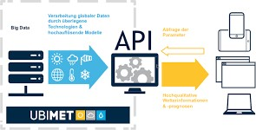
Weather API Project Overview
The Weather API Project is a cutting-edge system that provides real-time weather updates to users around the globe. Our goal is to provide accurate and reliable weather information that can be accessed from anywhere, at any time. The project's scope includes integrating multiple APIs and data sources to ensure that our users receive the most up-to-date information available. We are targeting a wide range of users, from individuals who need to plan their day-to-day activities to businesses that rely on weather information for decision-making. Our team has worked tirelessly to create a user-friendly interface that allows users to access weather information quickly and easily. The system is designed to be scalable, so we can accommodate a growing number of users without sacriﬁcing performance or accuracy. In addition to providing current weather conditions, the system also includes historical data, so users can track weather patterns over time. We believe that this project will revolutionize the way people access weather information and provide signiﬁcant beneﬁts to users worldwide.

Slide 7

Technical Details
The weather API project is built using a combination of programming languages, including Python, JavaScript, and HTML. The backend of the project is written in Python, which handles the processing and storage of data. The frontend of the project is written in JavaScript and HTML, which handle the user interface and display of information.The project integrates with several APIs, including OpenWeatherMap and Weather Underground.
These APIs provide real-time weather data and forecasts for various locations around the world. In addition, the project also uses data
from NOAA (National Oceanic and Atmospheric Administration) and other government agencies to ensure accuracy and reliability of the data.

Slide 8

TECHNOLOGY USED
HTML
CSS
JAVASCRIPT

Slide 9
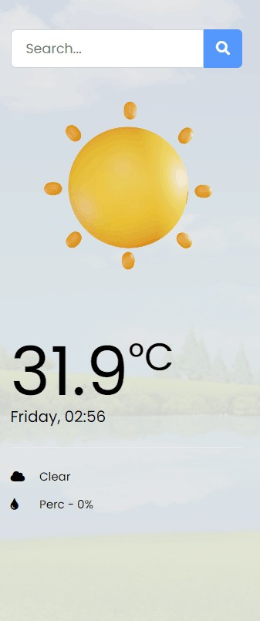
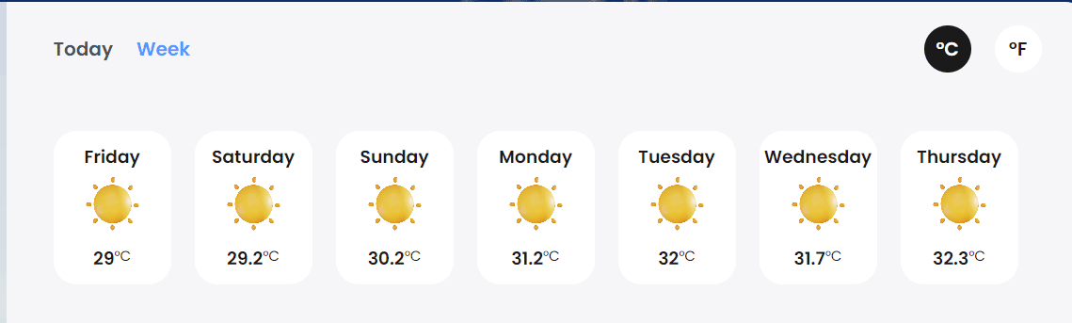
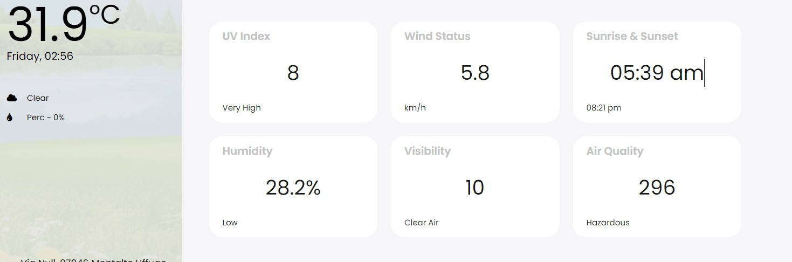
WEBSITE DESIGN

Slide 10
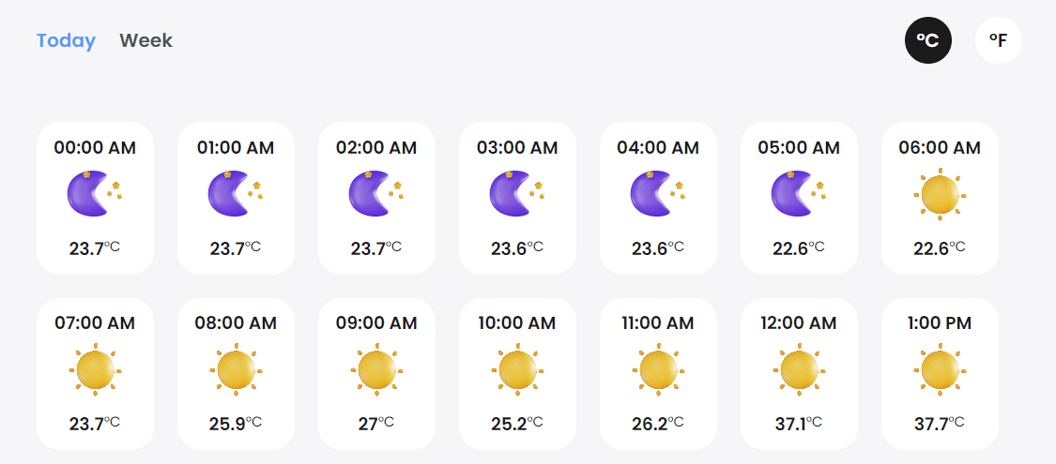

Slide 11
Why Weather Forecast Website?
As we all know, weather plays a crucial role in our daily lives, from planning outdoor activities to making important business decisions.
However, accessing accurate and up-to-date
weather information can be a challenging task, especially when dealing with large amounts of data. That's where weather APIs come in - they provide developers with a streamlined way to access weather data and integrate it into their applications, saving time and resources. But enough talk - let's explore this fascinating topic in more detail!

Slide 12
Conclusion
That is all about weather forecast website. It isdedicated to providing you with accurate and up-to-date information to help you plan your day. It's user-friendly interface and customizable alerts make it easy for you to access the information you need. Stay informed with the website and enjoy the sunny days ahead!

Slide 13
Thanks!

